Slide 1

Happy Paws
Let us treat your pet like our own family with best services and packages.

Slide 2
Team Members
- Yasmeen Mostafa - Abdelrahman Youssef - Mahmoud Badawy - Kareem Mamdouh

Slide 3
Table of contents
01
02
03
Introduction
Compititors
Survey
04
05
06
Proposed Solution
Tools & Technologys
Demonstration
Definition of problem
Compititors for the idea & what they offer
User survey data for the proposed idea
Introduction to Happy Paws & what it offers
Tools & techs used to create website
Presentation of website

Slide 4
01.
Introduction
What problems do pet owners face

Slide 5
02.
Compititors
What features do competitors have?

Slide 6
Compititors Features
 | Store |  |  | Services
 | Wishlist | Reviews | Categories filter | Adoption | Training | Grooming | Home visits | Blog
Vetwork | ❌ | ❌ | ❌ | ❌ | ❌ | ✔ | ✔ | ❌
Happet | ✔ | ✔ | ✔ | ❌ | ❌ | ❌ | ❌ | ✔
Petopia | ❌ | ✔ | ✔ | ✔ | ✔ | ✔ | ❌ | ✔
The pet shop | ✔ | ❌ | ✔ | ❌ | ❌ | ✔ | ✔ | ❌

Slide 7
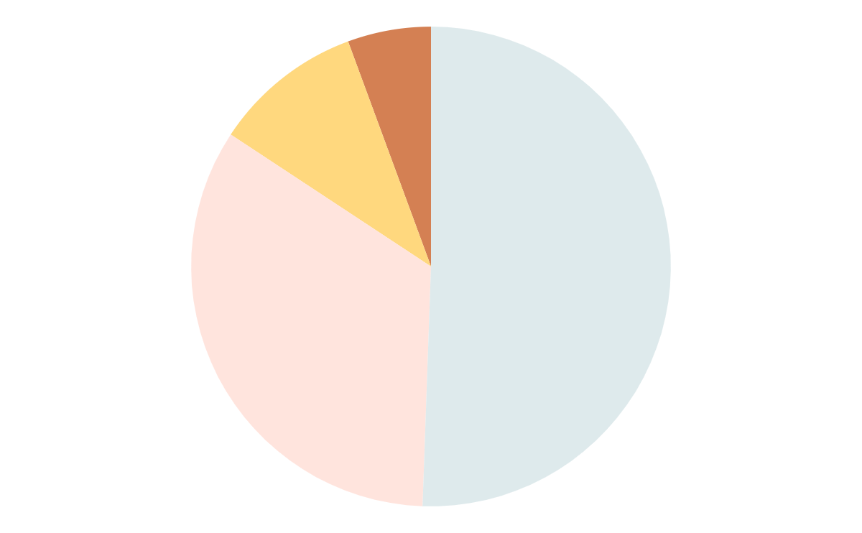
03.
Survey
User survey statistics

Slide 8
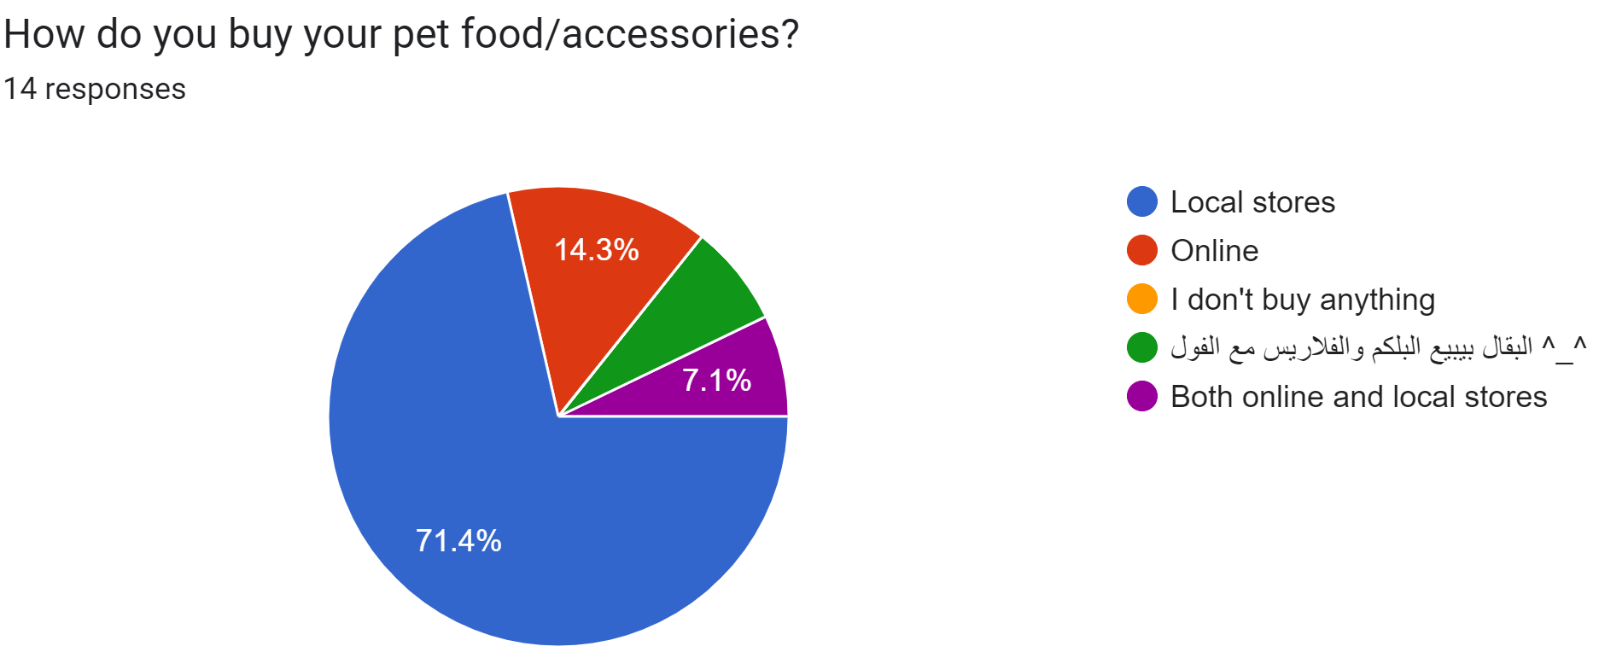
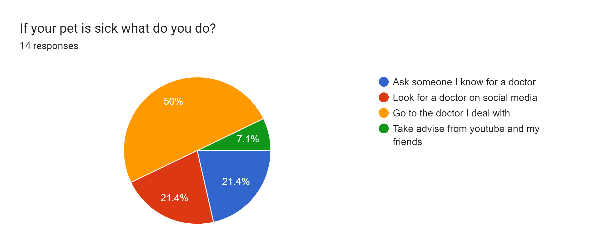
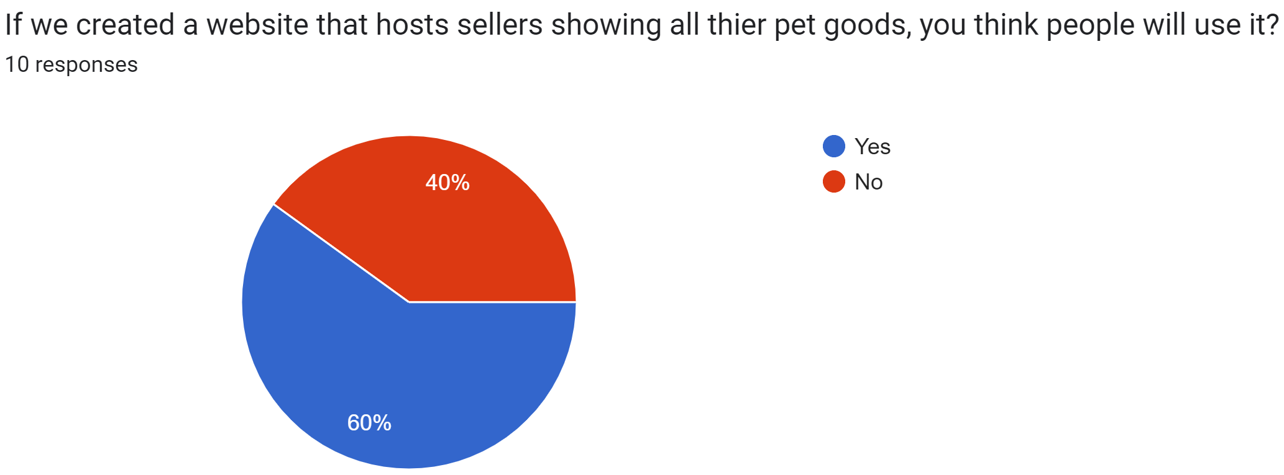

Slide 9
04.
Happy Paws
Proposed solution for pet owners

Slide 10

Store Features
Food
Litter
Wishlist
Toys
Accessories
Reviews
Grooming
Filtration

Slide 11
Services
Blog
Adoption

Slide 12
Future Features & Services
Grooming
Hosting
Medical Care

Slide 13
05.
Tools & Technologies
Technologies used to build application

Slide 14








Angular
TypeScript
Firebase
PrimeNG
BootStrap5
HTML5
SASS
PWA

Slide 15

06.
Project Demonstration
Live presentation for project

Slide 16
Thanks!

